Slide 1
Reddit web scraping Classification
Prepared for AMA Recruiting

Slide 2
USE Case (problem Statement)
Business Use Case: AMA specializes in recruitment for technology companies and wants to develop a classification model using Natural Language data from a publicly available forum data source
They want to use this classification system to find the most relevant threads online to distinguish general “financial” thread questions and threads related to computer science careers to develop targeted ad campaigns for potential hiring candidates

Slide 3
The process
1) Gather Data:
Web Scraping
2) Data Cleaning and Processing
3) Exploratory Data Analysis (EDA)
4) Building ML Classification models
5) Evaluating our Models
6) Making Conclusions about our Findings
Gather Data
Data Cleaning and Processing
Exploratory Data Analysis (EDA)
Building Machine Learning models
Evaluating our Models
Making Conclusions about our Findings

Slide 4


Reddit web scraping
Thread:
r/CSCareerQuestions
Original Scrape:
1500 Posts
After removing duplicates:
1179 Posts
Thread:
r/personalfinance
Original Scrape:
1500 Posts
After removing duplicates:
1252 Posts

Slide 5
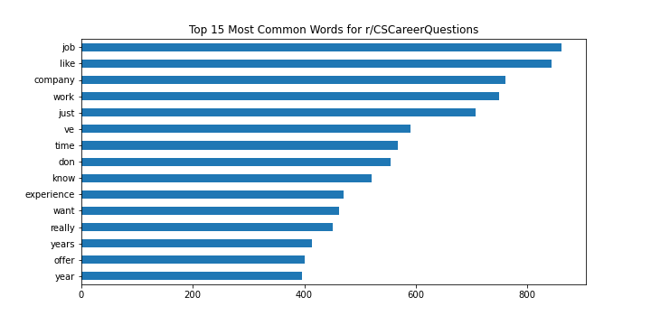
Exploring top words: CS Career Questions
We notice certain differentiating factors like “job,” “work,” “experience,” “offer” which are good indicator words for the type of words in this subreddit.

Slide 6
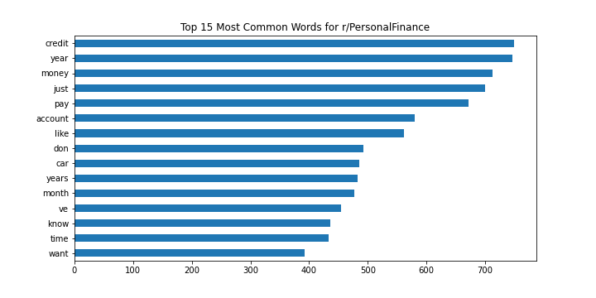
Exploring top words: Personal finance
We notice certain differentiating factors like “credit,” “money,” “account,” which are good indicator words for the type of words in this subreddit.

Slide 7
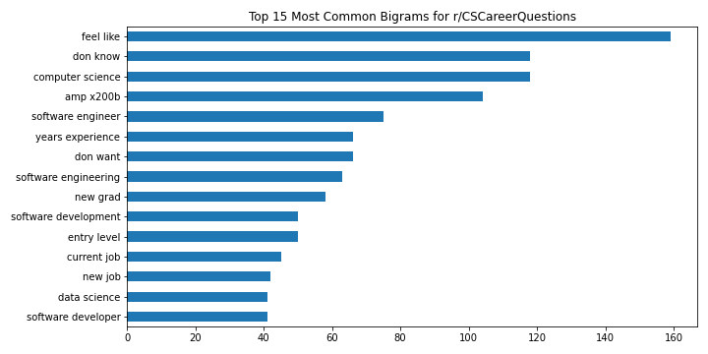
Exploring top BIgrams: CS Career Questions
We notice certain differentiating factors like “computer science,” “software engineer,” “years experience,” “current job,” “new job” which are good indicator words for the type of words in this subreddit.

Slide 8
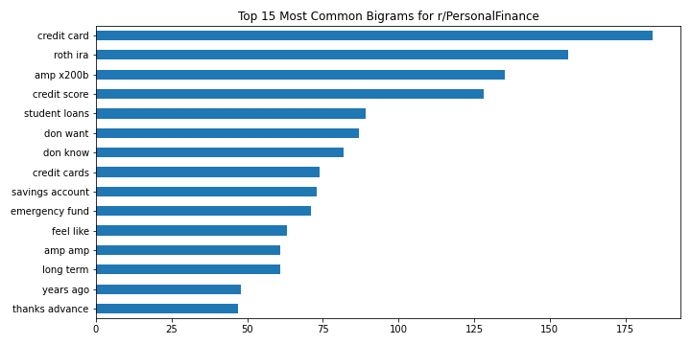
Exploring top BIGRAMS: Personal finance
We notice certain differentiating factors like “credit card,” “credit score,” “student loans,” “savings account,” etc. which are good indicator words for the type of words in this subreddit.

Slide 9
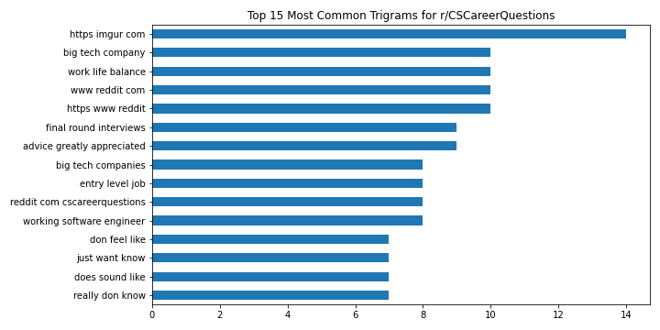
Exploring top TRIGRAMS: CS Career Questions
We notice certain differentiating factors like “job,” “work,” “experience,” “offer” which are good indicator words for the type of words in this subreddit.

Slide 10
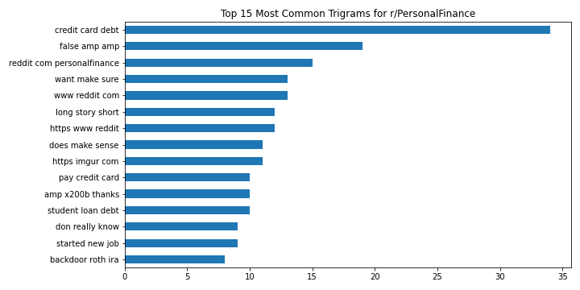
Exploring top TRIGRAMS: Personal finance
We notice certain differentiating factors like “credit,” “money,” “account,” which are good indicator words for the type of words in this subreddit.

Slide 11
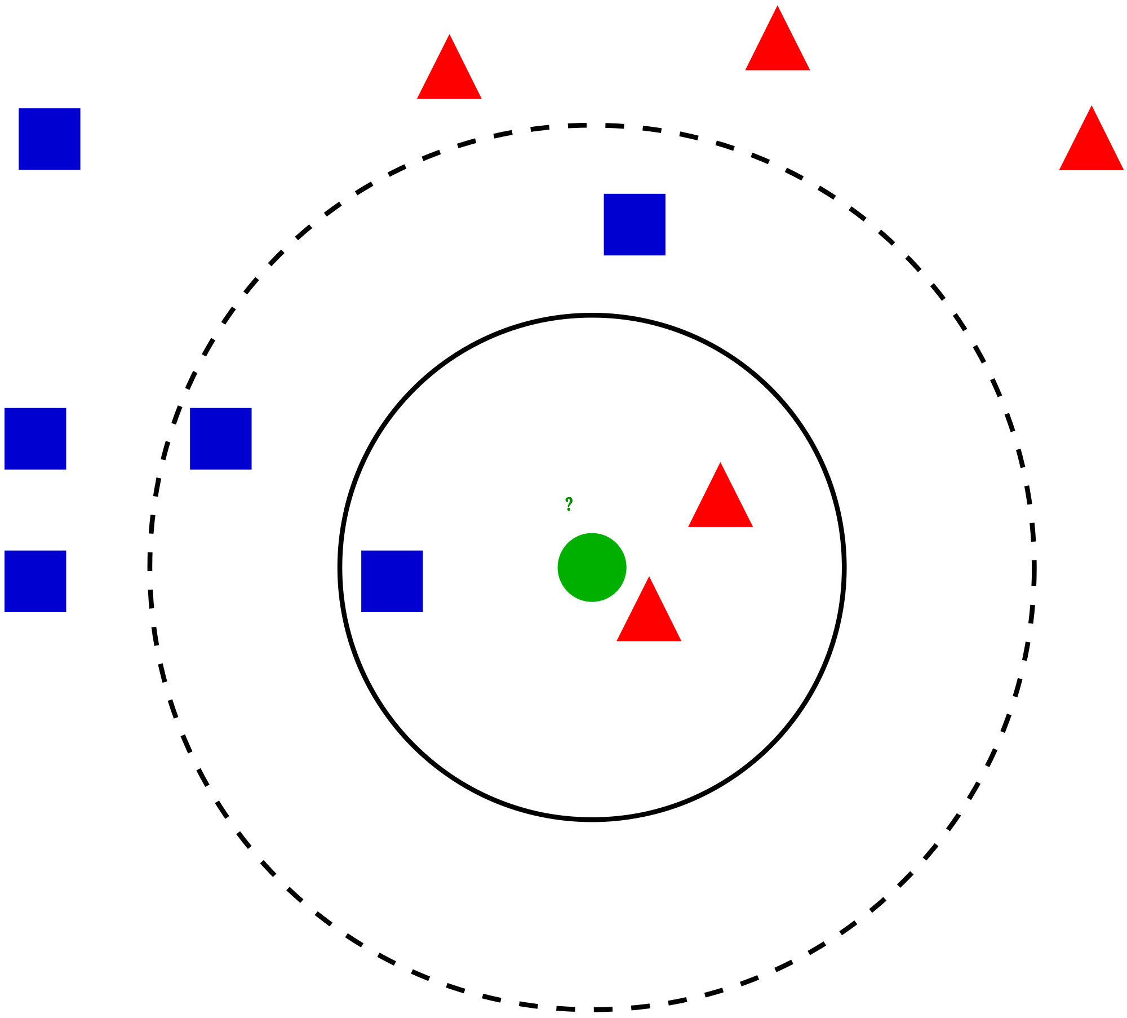
MODELING: K NEAREST NEIGHBORS
Classification between K Nearest Neighbors involves using predicting classification based on the classification of certain number of neighbors

Slide 12
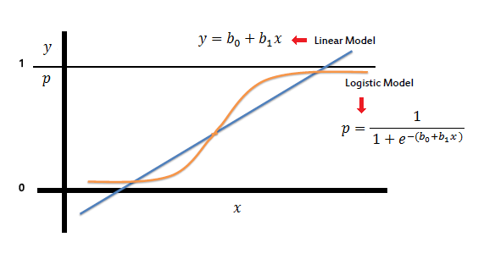
MODELING: logistic regression
Binary Classification between two categories performed by using a logistic model that separates predictions into “1” or “0” based on feature parameters

Slide 13
Classification model optimization and hyperparameter tuning
LOGISTIC REGRESSION
Model Iteration # | Description | Train Score | Test Score | Best parameters Used
1 | All Default Parameters | 0.94350 | 0.92763 | {} (baseline)
2 | Added English Stopwords | 0.95722 | 0.94079 | {'cvec__stop_words': 'english’, 'tfidf__use_idf': True}
3 | Added TFIDF model and 'solver' options for Logistic Regression Model | 0.96215 | 0.94243 | {'cvec__ngram_range': (1, 2), 'cvec__stop_words': 'english’, 'model__solver': 'newton-cg’, 'tfidf__use_idf': True}
KNearestNeighbors()
Model Iteration # | Description | Train Score | Test Score | Params
1 | All Default Parameters | 0.92212 | 0.91447 | {} (baseline)
2 | Added English Stopwords | 0.93693 | 0.92763 | {'cvec__stop_words': 'english’, 'tfidf__use_idf': True}
3 | Added TFIDF model and 'solver' options for Logistic Regression Model | 0.95667 | 0.93914 | {'cvec__ngram_range': (1, 3), 'cvec__stop_words': 'english', 'model__n_neighbors': 19, 'tfidf__use_idf': True}
Logistic Regression
Wins!

Slide 14
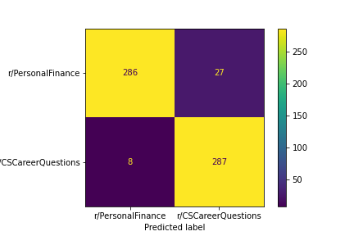

Classification model optimization and hyperparameter tuning
Logistic Regression
is more even across the board between the two subreddits with less errors
KNearestNeighbors
Has more errors (FP) for r/CSCareerQuestions

Slide 15
conclusions
Machine learning Classification is a valid way to distinguish corpus text (using NLP)
Logistic regression is a better model for the situation at hand for targeted messaging for CS hiring candidates

